Slide 1
Predicting Crude Oil Prices
Times Series Forecasting and Text Mining Analysis
Mazhar Kodithodika

Slide 2
Problem Statement/Background
• Crude Oil is a commodity, so it tends to see larger fluctuations in price than more stable investments such as stocks and bonds
• As with any commodity, stock or bond, the laws of supply and demand cause oil prices to change
• Supply and demand as well as the oil futures market affect oil prices
• Political instability in the Middle East causes oil prices to fluctuate, as the region accounts for the lion’s share of the worldwide oil supply
• West Texas Intermediate(WTI) and Brent Crude Oil: WTI price is selected for Analysis

Slide 3
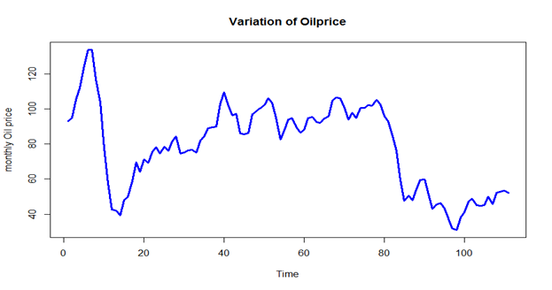
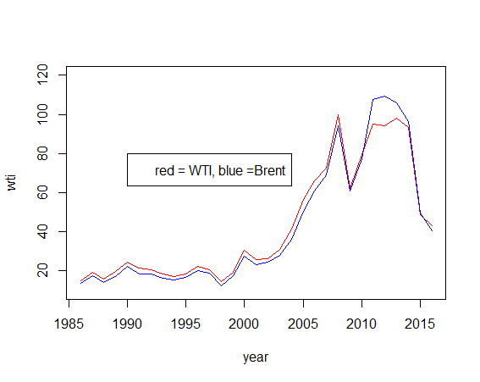
Time Series Forecasting:
Plot of Crude Oil Price(WTI)
R code:
plot(y, type = 'l',xlab='Time',ylab='monthly Oil price',col="blue",main="Variation of Oilprice",lwd=3)

Slide 4
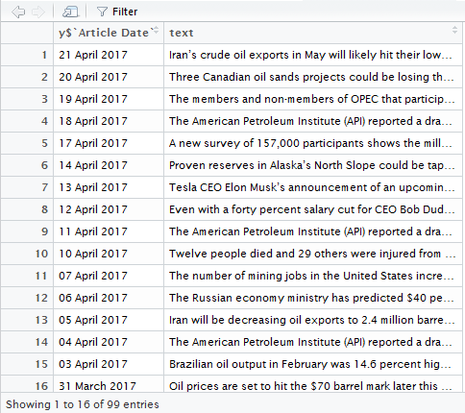
Text Scraping
library(rvest)
library(dplyr)
"Oil Prices" <-read_html("http://oilprice.com/search/tab/news/oil_prices/")
titles= `Oil Prices`%>%
html_nodes("#search-results-news p") %>%
html_text()
titles
dates= `Oil Prices`%>%
html_nodes(".dateadded") %>%
html_text()
dates
"News Articles" = as.data.frame(`dates`)
`News Articles`$abstract <- titles
*The items in red were extracted from webpage using the google chrome “selectorgadget” extension

Slide 5
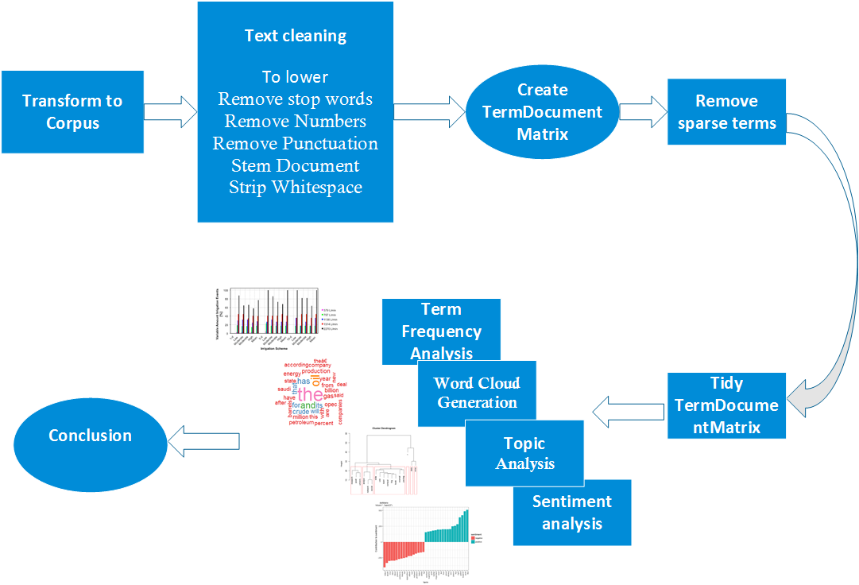
Text Mining

Slide 6
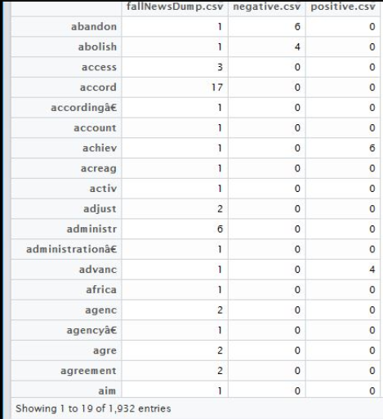
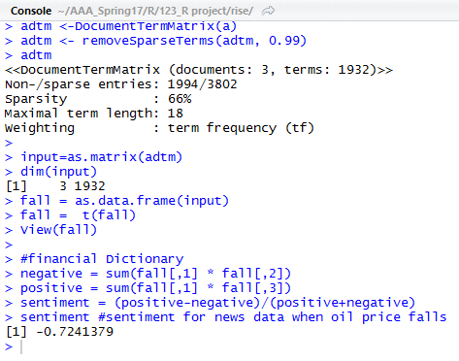
Text Mining Results
Sentiment is more negative when the oil prices fall : less than -0.5
Sentiment is less negative when oil prices rise: Greater than -0.5
Sentiments in daily news articles that are more negative suggest the oil price will fall
Oil Price Fall

Slide 7
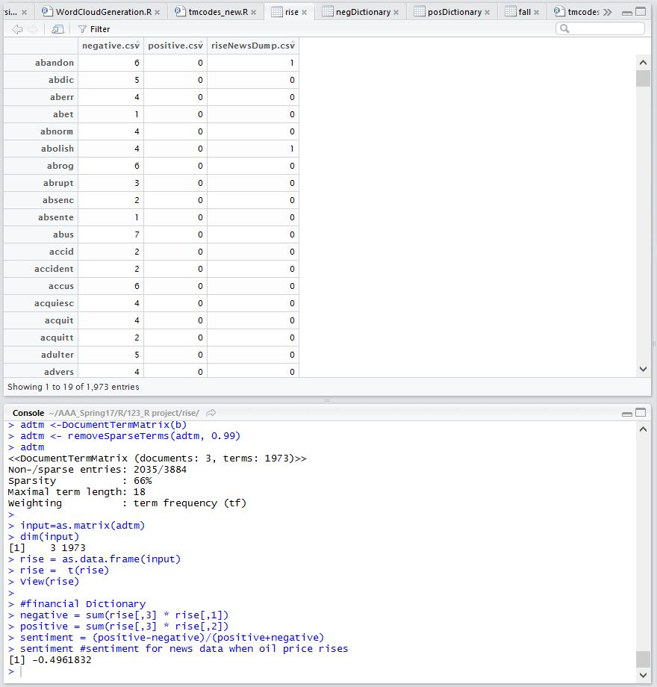
Text Mining Results - Oil Price rise

Slide 8

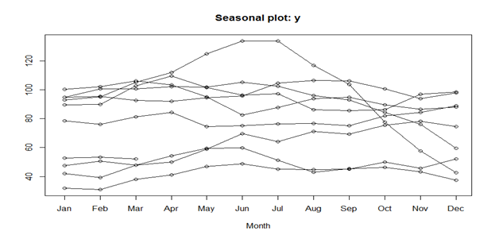

Time Series Forecasting:
Checking Trend and Seasonality
Trend: There is trend
install.packages("tseries")
library(tseries)
adf.test(diff(y), alternative="stationary", k=0)
Seasonality: There is no seasonality
install.packages("forecast")
library(forecast)
seasonplot(y,12,test="ocsb")
nsdiffs(y,12,test="ocsb")

Slide 9
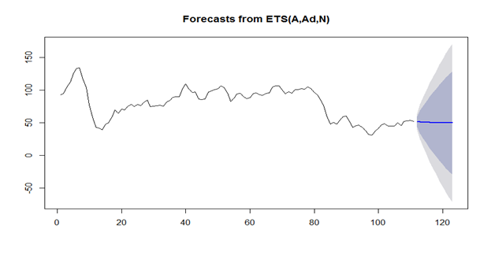
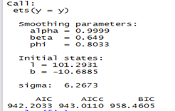
Time Series Forecasting:
Exponential Model - Code, Results and Plot
Exponential time series:
fit <- ets(y)
plot(fit)
accuracy(fit)
plot(forecast(fit, 12))

Slide 10
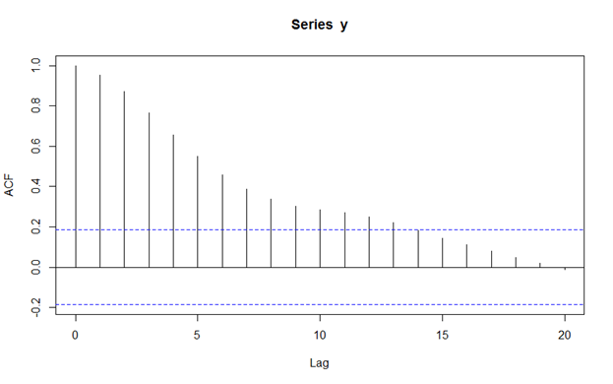
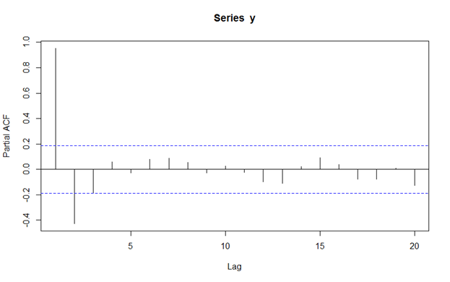
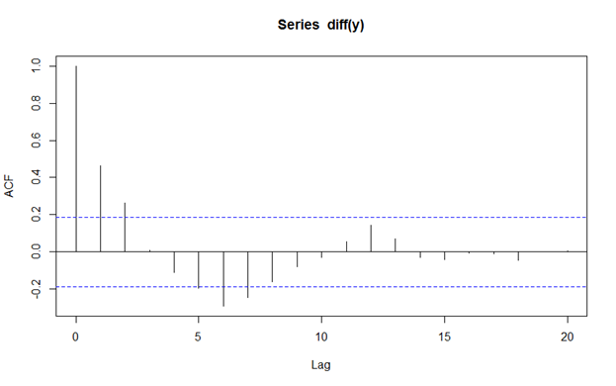
Time Series Forecasting:
Autocorrelation and Partial Autocorrelation plots
R code:
acf(y)
acf(diff(y))
pacf(y)
pacf(diff(y))

Slide 11
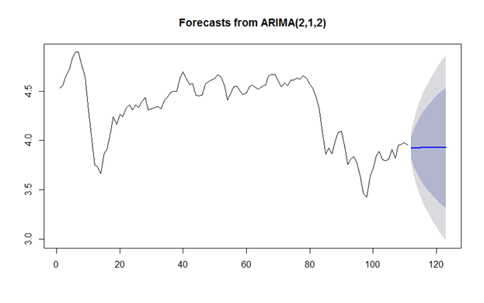
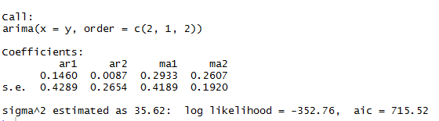
Time Series Forecasting:
ARIMA Model
ARIMA MODEL(2,1,2)
(from acf and pacf plots)
fit <- arima(y, order=c(2, 1, 2))
fit
accuracy(fit)
forecast(fit,12)
plot(forecast(fit,12))

Slide 12
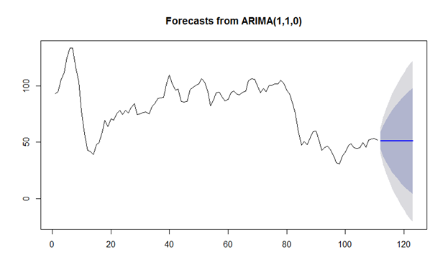
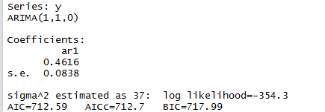
Time Series Forecasting:
Auto ARIMA Model
Auto ARIMA Model:
model_arima <- auto.arima(y)
model_arima
fcast_arima <- forecast(model_arima, h = 12)
plot(fcast_arima)
Model Accuracy:
RMSE: 6.027
MPE: -0.33
MAPE: 6.65

Slide 13
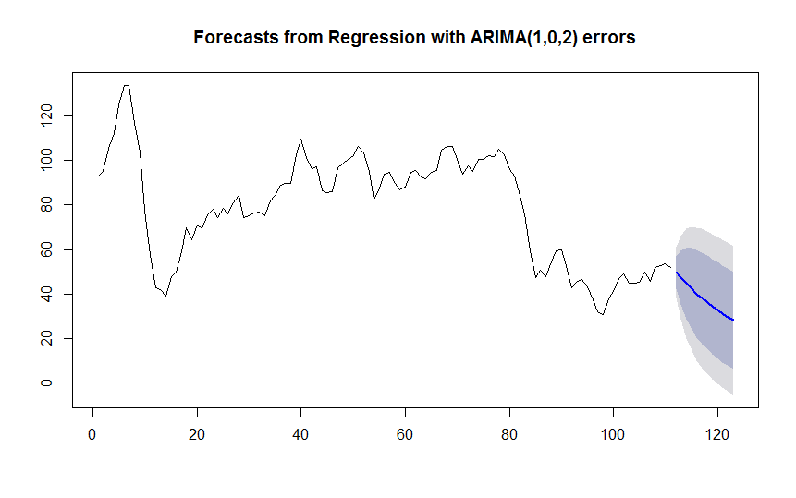

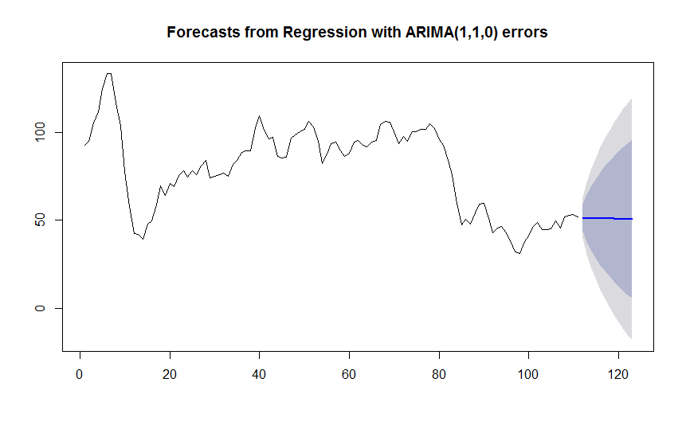
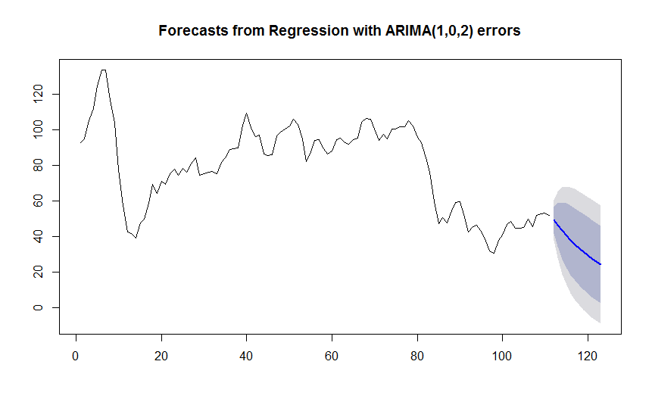
Time Series Forecasting:
Auto ARIMA Model - With Regressors
hfhfhfh
Population, Oil Eq per capita, KWH per capita
Population, Oil Eq per capita.
Oil Eq per capita, KWH per capita
Population, KWH per capita

Slide 14
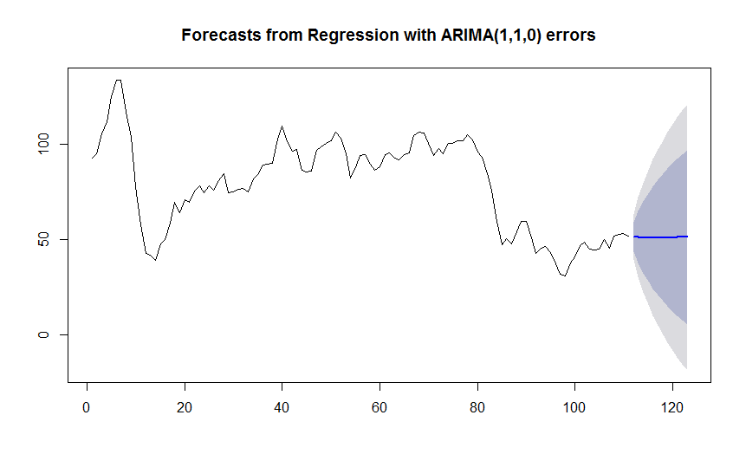

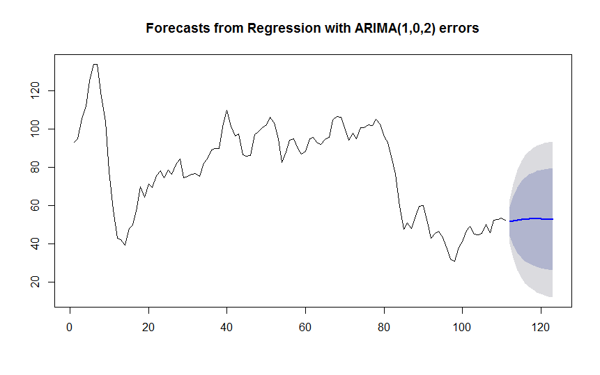
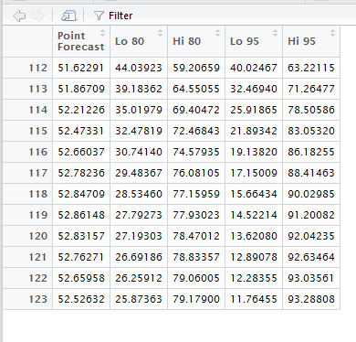
Time Series Forecasting:
Auto ARIMA Model - With Regressors- cont..
KWH per capita.
Oil Eq per capita
Population
, KWH per capita
Population.

Slide 15
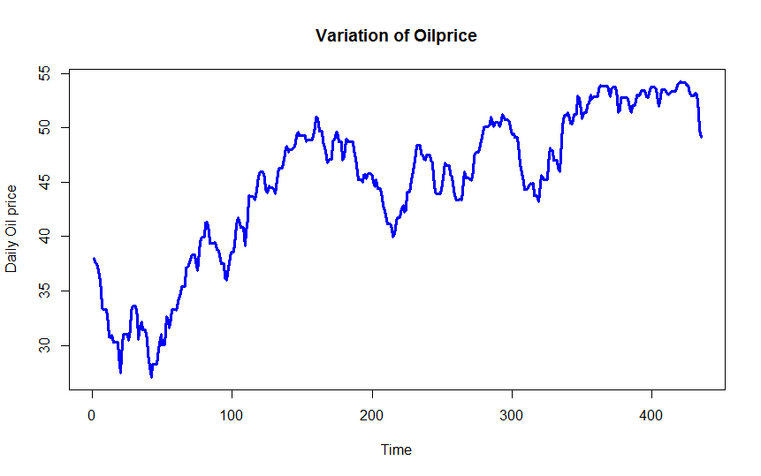
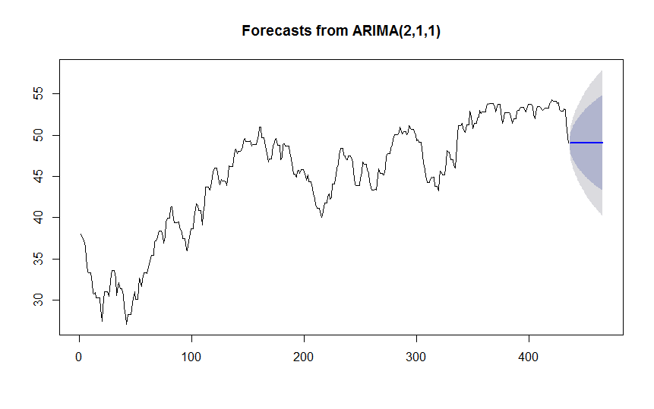
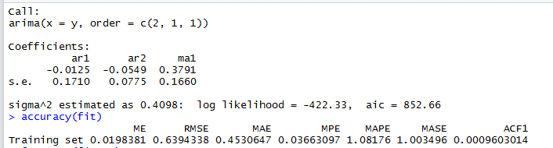
Time Series Forecasting:
Time series plot and Arima Model - With Daily Price
plot(y, type = 'l',xlab='Time',ylab='Daily Oil price',col="blue",main="Variation of Oilprice",lwd=3)

Slide 16

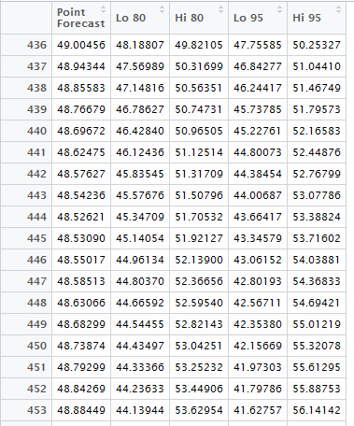
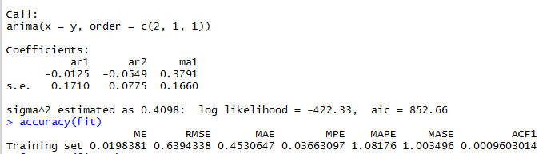
Time Series Forecasting:
Auto ARIMA Model - With Daily Price

Slide 17
Conclusion and Recommendations
Using time series forecasting, oil prices can be predicted up to MAPE of 1.08%
However, real time changes can be accommodated into model using text mining
News article text mining can help to predict the trend of oil price fluctuation
More comprehensive oil specific training dictionary could be made for better predictive accuracy.
Geopolitical instability index to be developed using text mining to predict the trend of the oil price fluctuation

Slide 18
Thank you

